Slide 1
ICS Michelini-Tocci Cagli Italy
Report activities
3° semester

Slide 2
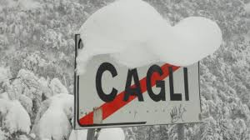
Welcome to Cagli under the snow

Slide 3
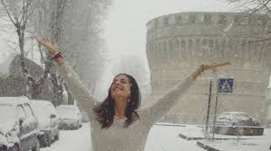
….and from Siberia, Burian is here !!!!!!

Slide 4
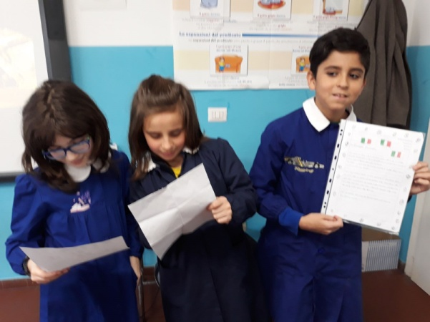
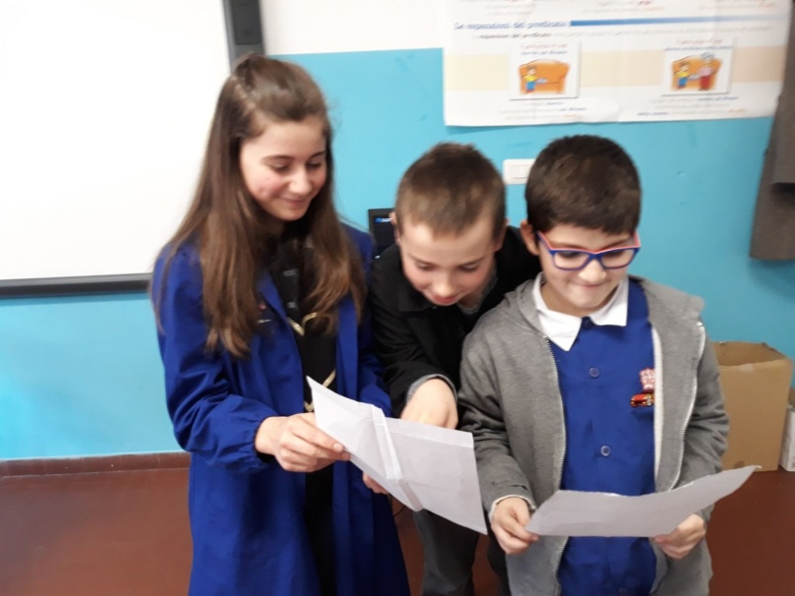
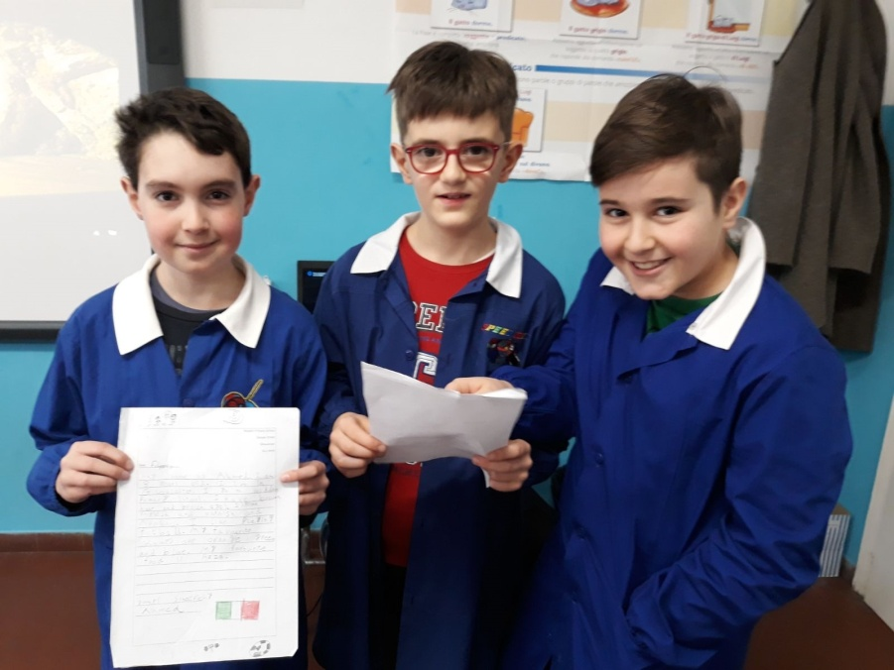
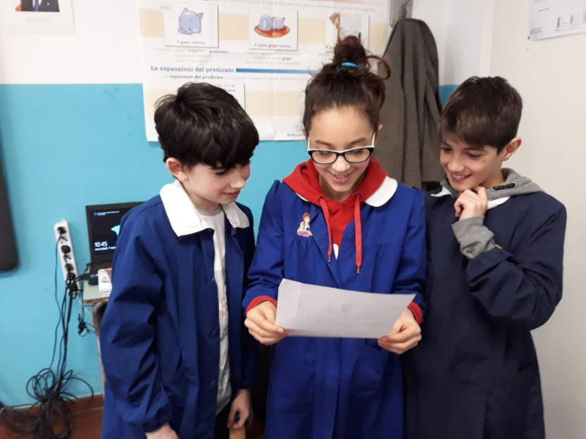
Pen pal network
4^- 5^ classes Cantiano

Slide 5
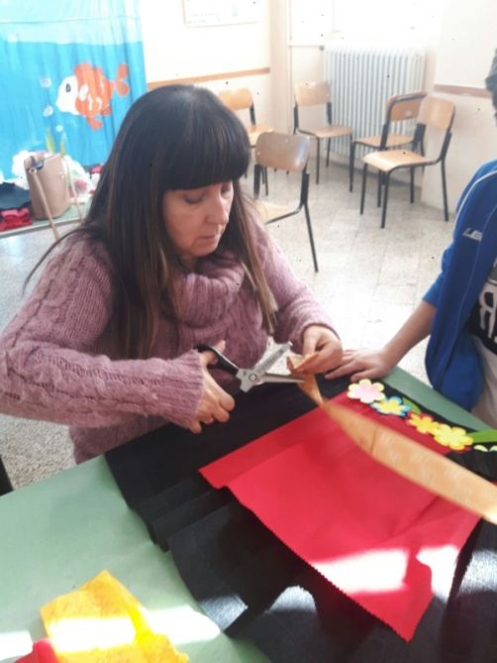
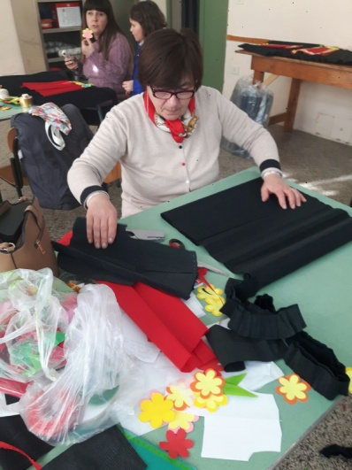
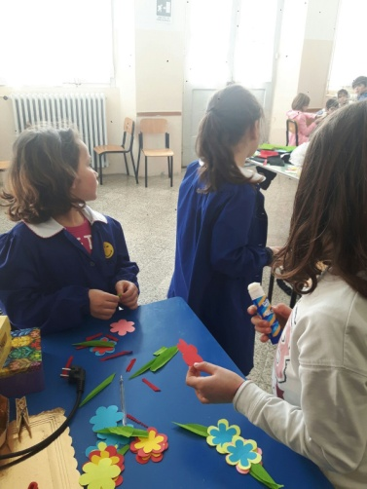
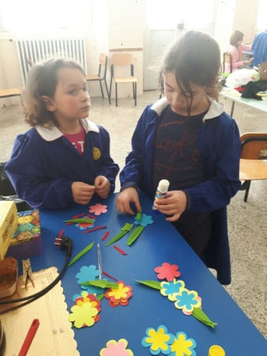
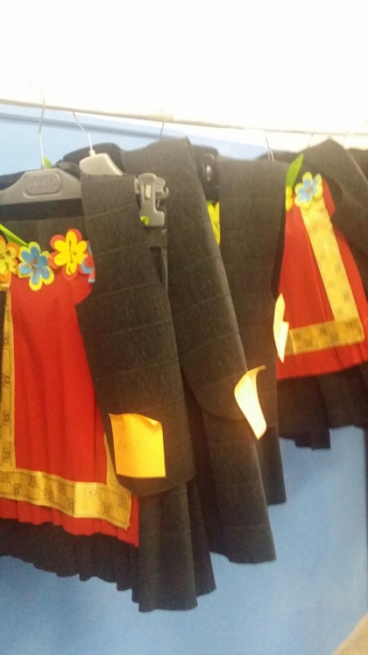
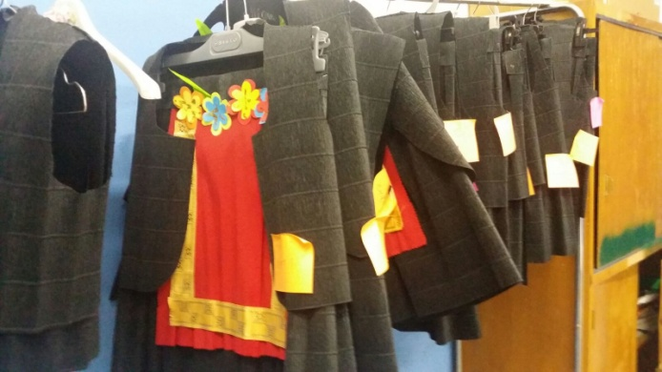
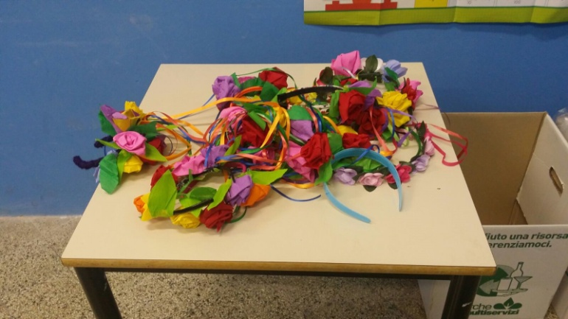
TRADITIONAL DANCE
Kindergarten and Prymary school Pianello

Slide 6
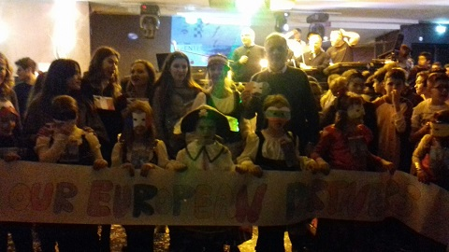
CARNIVAL DAY
All classes of our Institute
Party to our European partners ERASMUS Plus Project

Slide 7
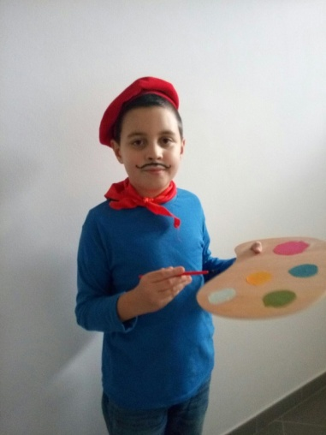
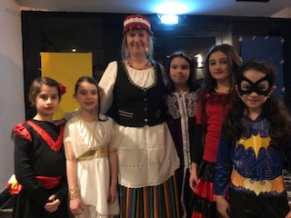
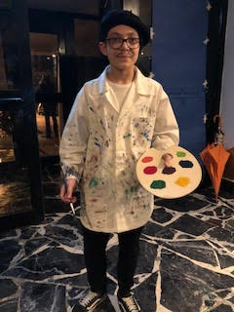
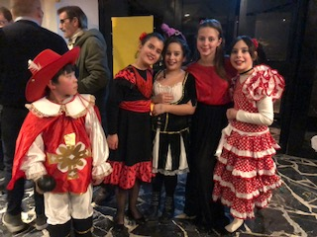
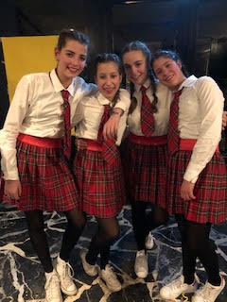
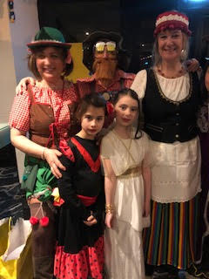
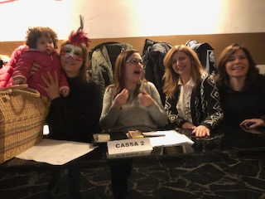
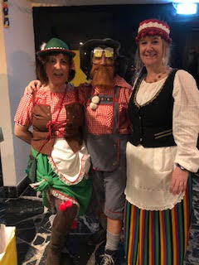
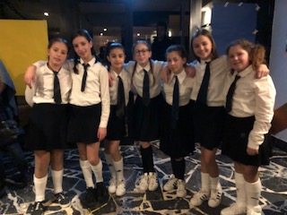
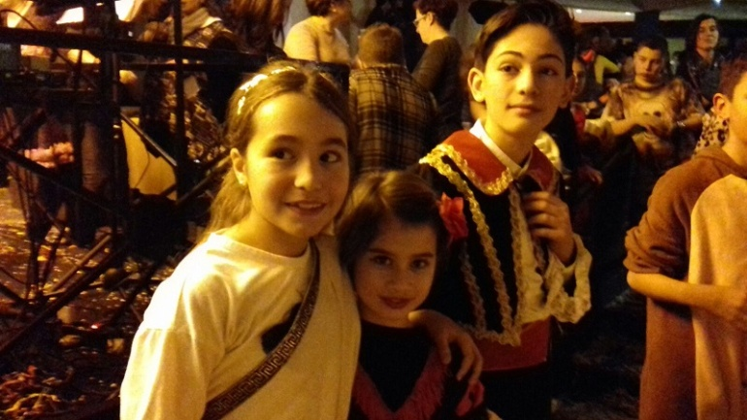

Slide 8
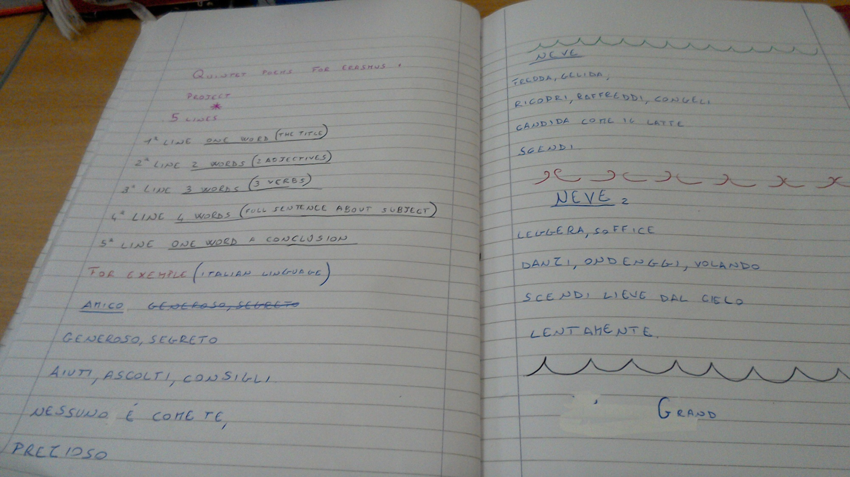
QUINTET POEM

Slide 9
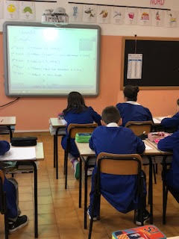
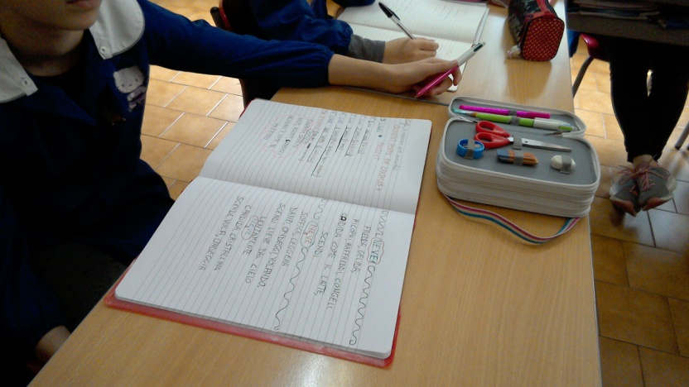
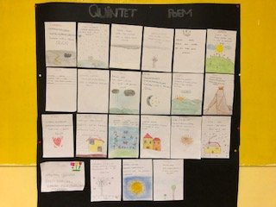
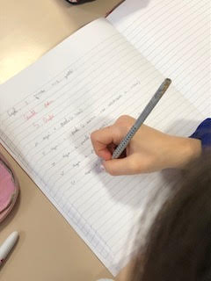
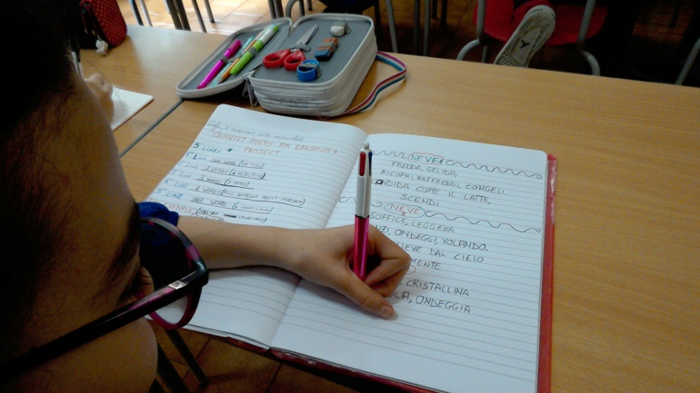

Slide 10
TRANSLATE
Snow 1
Light, soft
dance, flutter, flying.
Fall, delicate from the sky,
Slowly.
Friend
Generous, secret
help, listen, suggest.
None is as you
precious.
Snow 2
Cold, freezing
Ricopri, raffreddi, congeli
Bianca come il latte
scendi
Football
Beautiful, fun.
Running, kicking, standing
It’s the greatest game,
emotional
Mum
Tender, beautiful,
Clean, spread, iron.
Don’t take a break,
unique.

Slide 11
Video diary

Slide 13
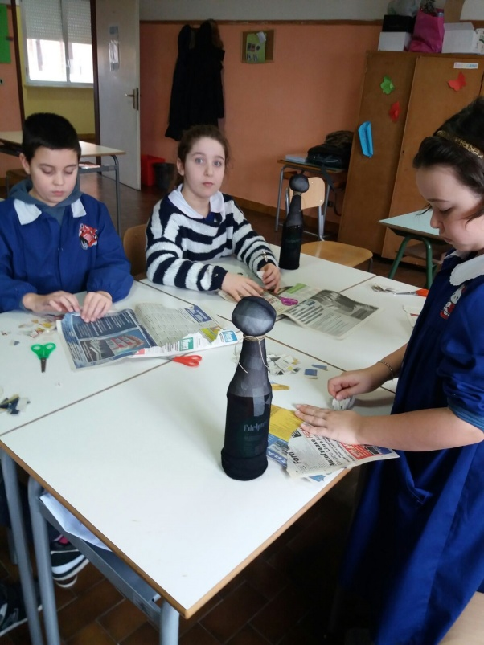
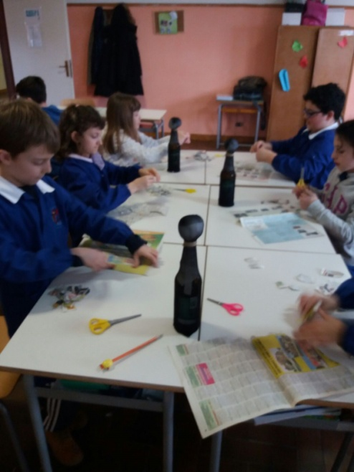
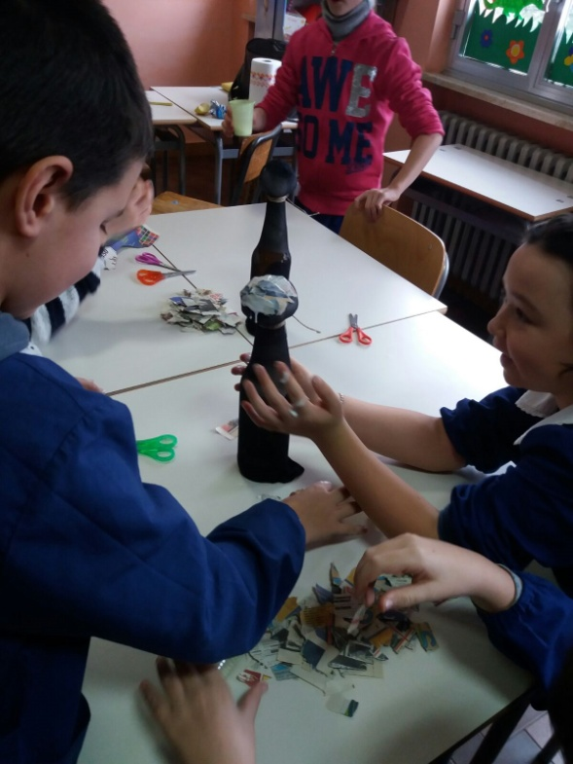
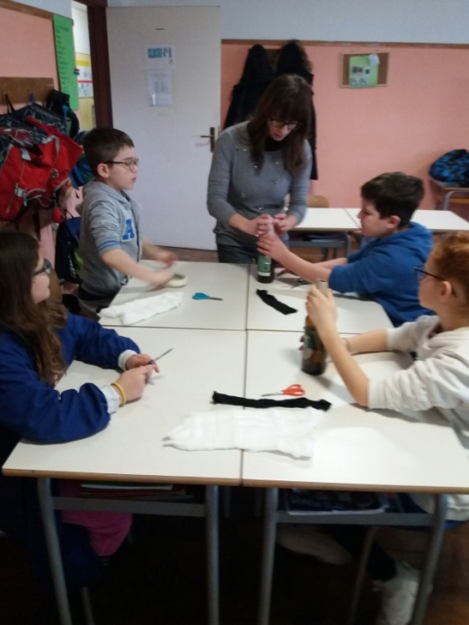
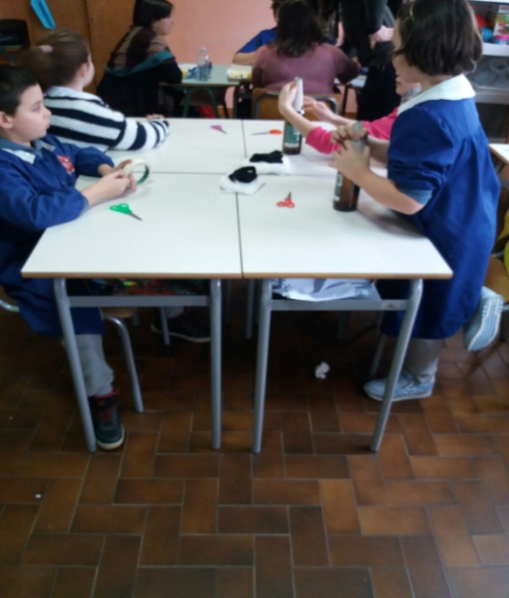
PUPPETS

Slide 14
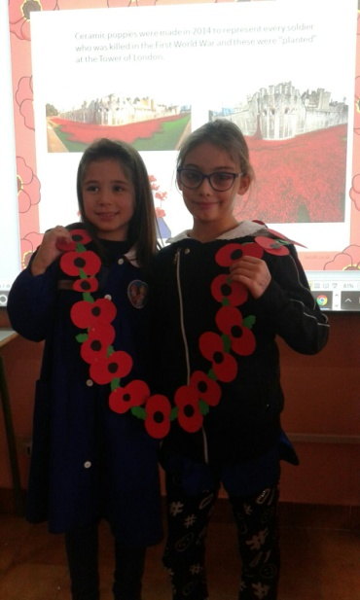
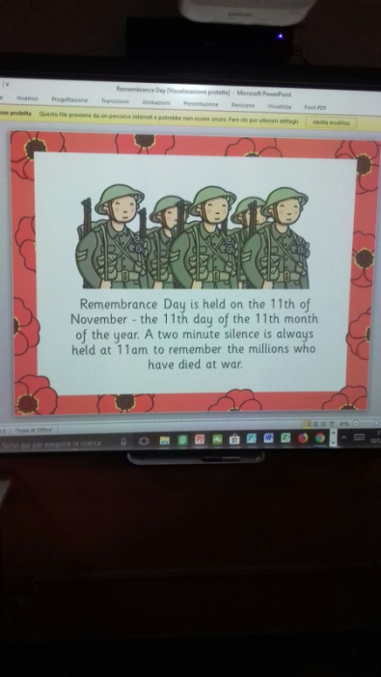
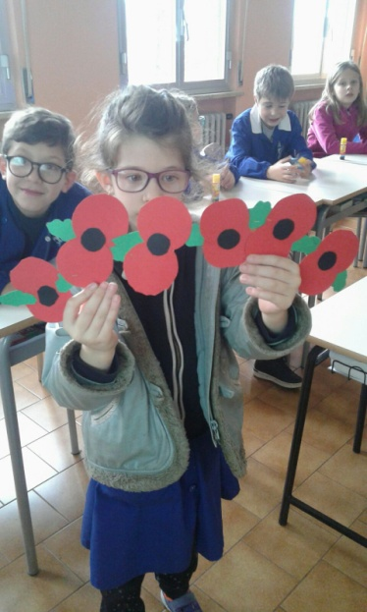
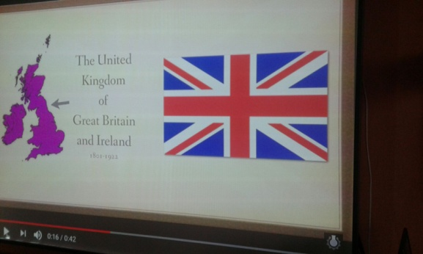
ERASMUS DAY 12th december
First, the teacher explained what Remembrance Day is and talked about its origins and history, then she gave pupils the raw material to make poppies and pupils worked on them. After that, two pupils recited in front of the class the first part of the poem “In Flanders Fields” by John McCrae both in English and Italian and the teacher explained the symbolic meaning of poppies linked to this poem words. Then the class worked on the Union Jack; the teacher explained its history through the use of slides, showed each flag that compose it and pupils drew them.

Slide 15
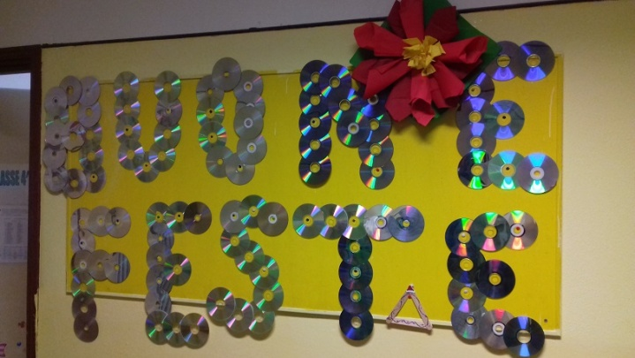
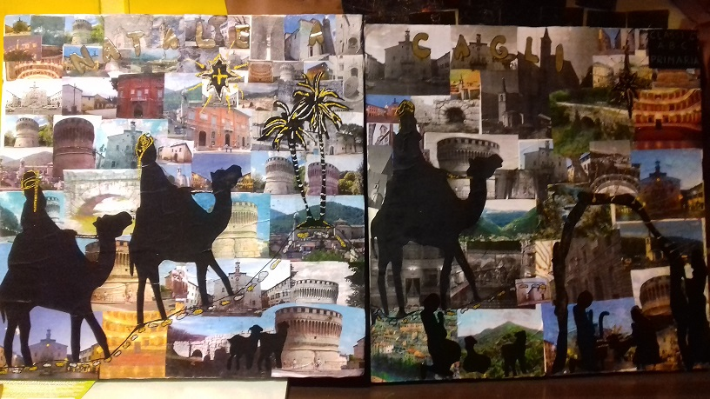
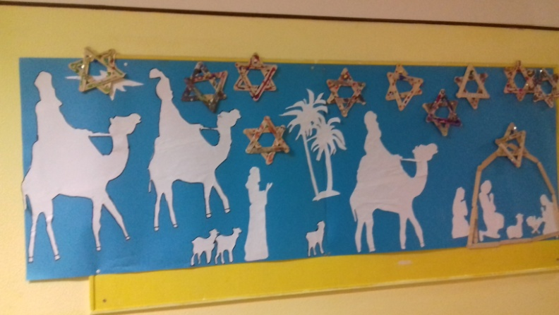
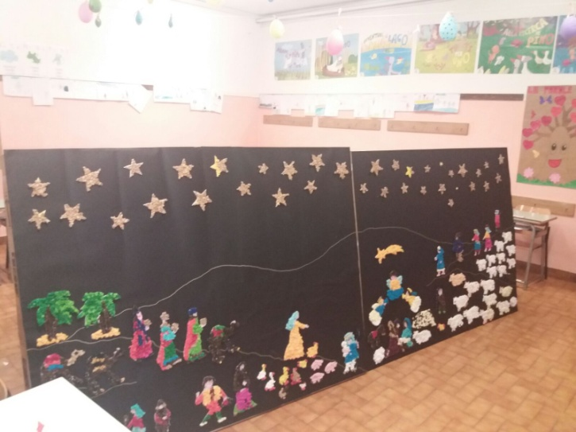
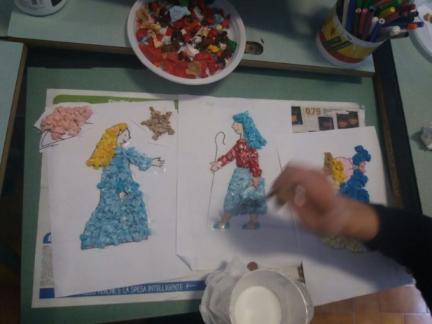
Christmas activities

Slide 16
TRASFERTA ROMANIA

Slide 17
bulgaria

Slide 18
AND NOW …….
SEE YOU SOON TO CAGLI
ON MAY

