Slide 1
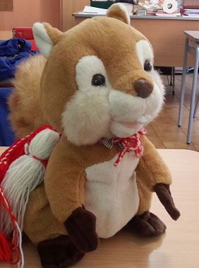
ERASMUS PLUS 2016 – 2019 REPORT 2° SEMESTER

Slide 2
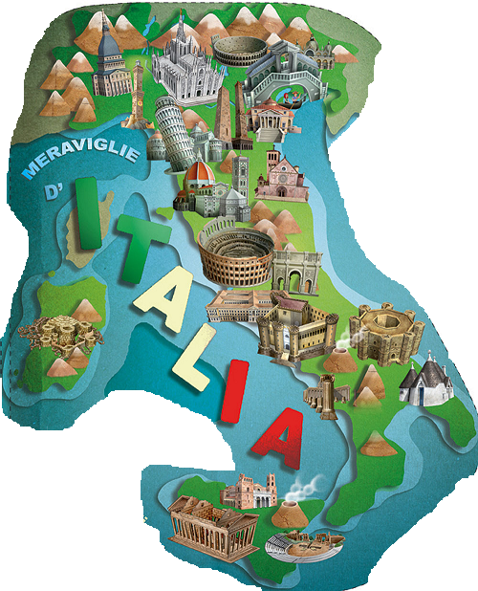
ERASMUS PLUS PROJECT
Arts and Traditions in modern settings

Slide 3
2° semester activities group Svezia-Italia-Romania

Slide 4
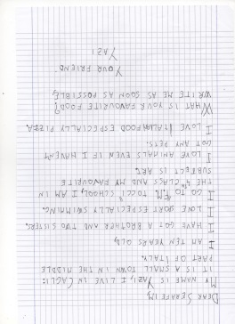
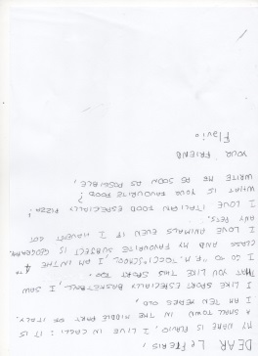
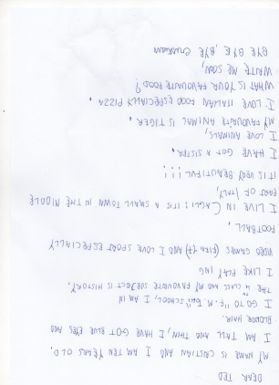
Report 2° semester activities
Pen-pals
Correspondence between pupils of the three schools partner: exchange best wishes for
happy holidays : Classes 3^ C Ins. SimonaPolidori

Slide 5
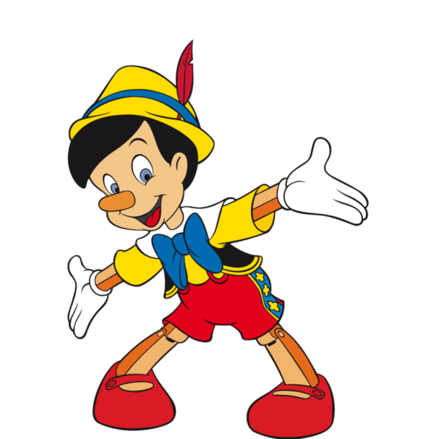
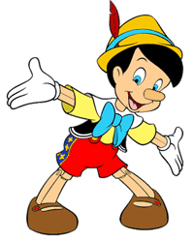
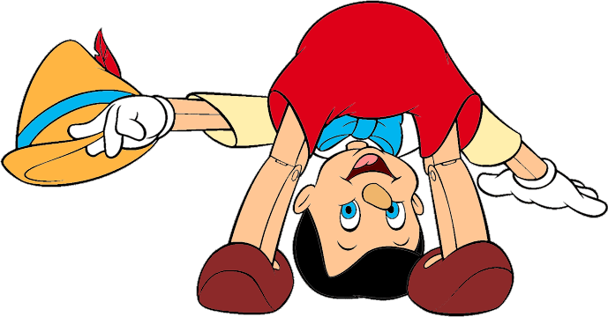
2. Story in English with morals
Final essay
Classes 2^ A-B Ins. Orazi
PINOCCHIO

Slide 6
3. The Three best italian songs in the world
Short presentation in PP of 3 songs
more representative of Italy in the world and their history
Classes 5^ Ins. Gamba
ITALIAN SONGS

Slide 7
4. Body song
Invention of lyrics and music and choral
song about body parts
(in Italian and English languages)
Ins. Gamba and out side expert of music
Classes 4^

Slide 8
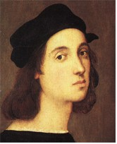
5. Italian Artist Rafael Sanzio
General information; film biography vision,
and reproduction in the classroom of some works with watercolor
Classes 5^ Ins. Lamarca

Slide 9
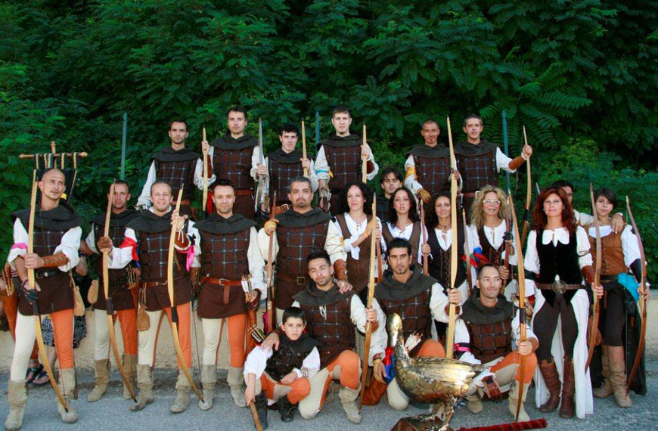
6. Traditional dresses the archers of «Palio dell’Oca»
Realization of two traditional clothes
Classes 5^ Ins. Gamba

Slide 10
7. Patterns
Playing traditional motifs:
photo and video tutorial
Classes 3^ Ins. Orazi

Slide 11
8. Erasmus day
Monday, 18th September 2017
Celebration of two partner schools with video, songs, dances……
Classes 4^ Ins. Polidori

Slide 12
9. STOP MOTIONS
In Italy the beginning and end of the school doesn’t coincide with other countries Erasmus Plus and
from June to mid-September we are on summer holidays. For this reason, his activity hasn’t been
carried out.
We prepare a stop motions for next October.
Classe 5^ Ins. Mariotti

