Slide 1
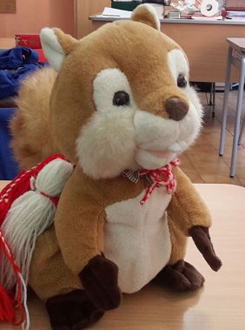
ERASMUS PLUS 2016 - 2019
REPORT 1st SEMESTER

Slide 2
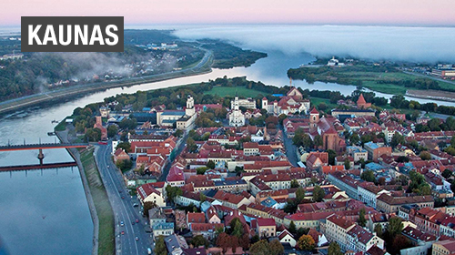
1° PLANNING: Kaunas lituania

Slide 3
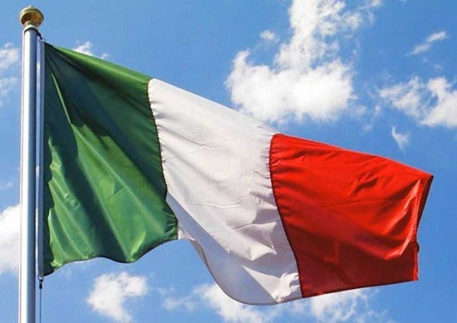
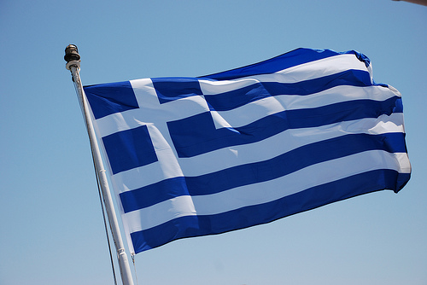
1° semester activities group Lituania-italia-grecia

Slide 4
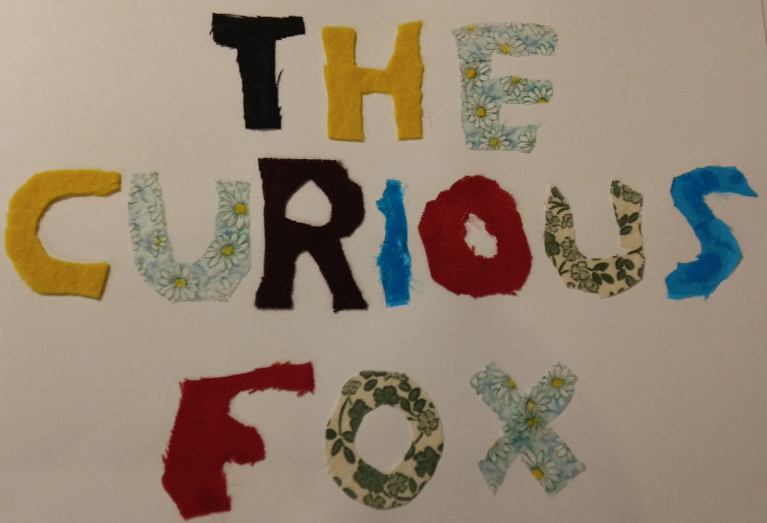
Report 1° semester activities STORY ROUND Mrs Luana Orazi wrote the story with classes 2 a-b (7 years old), 46 pupils The story was read by Mrs Gamba and Mrs Benedetti with the pupils of class 4 C (9 years old), 17 pupils

Slide 5
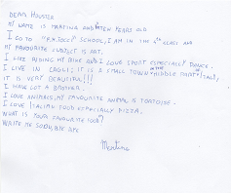
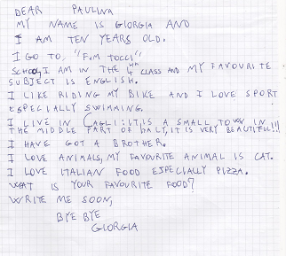
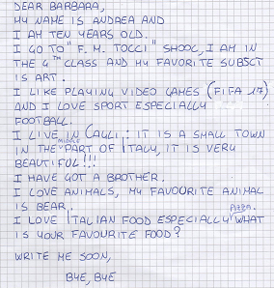
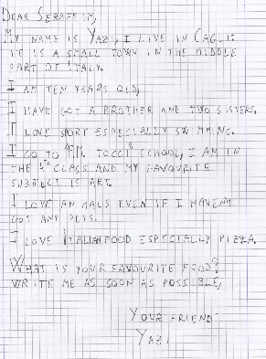
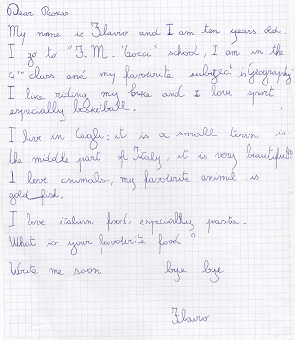
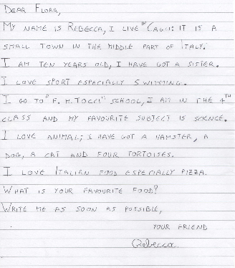
PEN-PAL network Mrs Giuseppina Gamba and Mrs Valeria Benedetti classe 4C alunni 17

Slide 6
ITALIAN FAMOUS ARTIST Mrs Giuseppina gamba and Mr Federico Burani

Slide 7
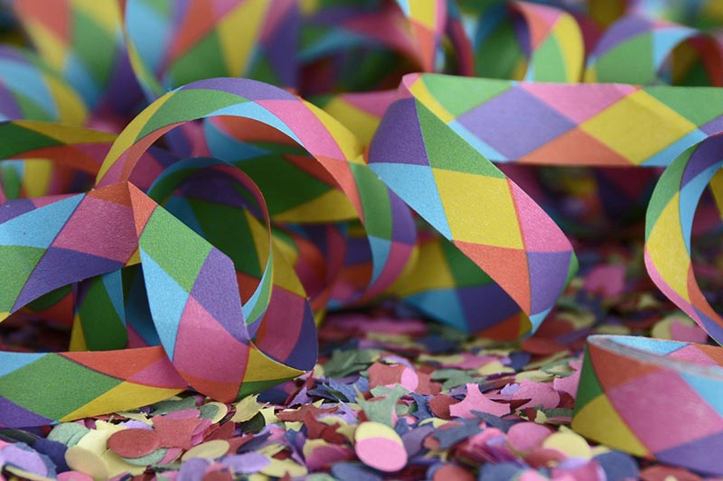
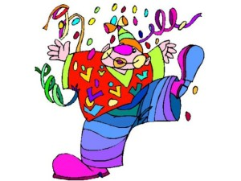
CARNIVAL DAY Mrs Giuseppina Gamba and class 4C (17 pupils)

Slide 8
ERASMUS DAY Tuesday 7th March 2017 .

Slide 9
Erasmus Day Agenda: Quiz on the Country’s Presentation Pen-Pal meeting story from story rounds in English Sing National Anthem 1. Body parts song 2. Video Diary

Slide 10
Video diary Mrs Giuseppina Gamba and a pupil from class 4A

Slide 11
The bodysong Ins. Gamba, maestro Del bianco classe 4^c 17 alunni
Ma la testa dov’e’?
Where is the head?
OCCHI GRANDI PER GUARDARE, IL CIELO, I PRATI E IL COLORE DEL MARE NASO FINO E DI TUTTI I FIORI L’ODORE POTRAI RITROVARE VOCE E CUORE PER CANTARE INVECE DI GRIDARE O PICCHIARE E LABBRA ROSSE PER PARLARE, AMARE E ASSAPORARE. CON LE ORECCHIE PUOI SENTIRE I RUMORI DELLA SERA LE VOCI DEI TUOI CARI, LE CANZONI, GLI UCCELLI A PRIMAVERA POI LE MANI CHE GRAN COSA, UN FASCIO DI MORBIDI PETALI ROSA CON LORO PUOI TOCCARE, STRAPPARE , IL VISO DELLA MAMMA ACCAREZZARE. IL NOSTRO MONDO HA GRAN SEGRETI DA SVELARE TU HAI SENSI ED IL TUO CORPO PER SCOPRIRE TUTTA UNA VITA PER POTERLI ESERCITARE MERAVIGLIE E GRAN MISTERI DA SCOVARE. GAMBE FORTI PER SALTARE, GIOCARE A CALCIO E CAMMINARE PIEDI SALDI PER SCALARE E CIME ROCCIOSE CONQUISTARE BRACCIA LUNGHE PER NUOTARE FRA GLI SPLENDIDI PESCI DEL MARE UN CUORE PER AMARE E CON QUELLO IL MONDO CONQUISTARE. MA LA TESTA DOV’E’? NELLA LISTA NON C’E’! NON E’ SOLO UNA PALLA VUOTA, DENTRO E’ASSAI PREZIOSA E IN QUELLA SOFFICE NUVOLA ROSA C’E’ L’ESSENZA VERA DI TE USALA IN OGNI MOMENTO E SARAI INVINCIBILE PIU’ DEL VENTO. PENSA!!!!!!!!!
BIG EYES TO WATCH THE SKY, THE MEADOWS AND THE COLOR OF THE SEA
NOSE UP AND SMELL THE FLOWERS OF ALL YOU CAN FIND
VOICE AND HEART TO SING INSTEAD OF CRYING OR HITTING
AND RED LIPS TO SPEAK, TO LOVE AND ENJOY.
WITH EARS CAN YOU HEAR THE SOUNDS OF THE EVENING THE VOICES OF YOUR LOVED ONES,
THE SONGS, THE BIRDS A SPRING THEN THE HANDS BIG DEAL,
A BEAM OF SOFT PINK PETAL WITH THEM YOU CAN TOUCH, TEAR,
THE FACE OF MOTHER CARESS.
OUR WORLD HAS GREAT SECRETS TO DISCLOSE YOU HAVE SENSES
AND YOUR BODY TO DISCOVER A WHOLE LIFE ABLE TO EXERCISE
WONDERS AND GREAT MYSTERIES TO FIND.
STRONG LEGS FOR JUMPING, PLAYING FOOTBALL AND WALKING FEET
SALE FOR ROCK CLIMBING ROPES AND CONQUER
ARMS LONG FOR SWIM BETWEEN THE BEAUTIFUL FISH OF THE SEA
AND WITH A HEART TO LOVE IS TO CONQUER THE WORLD.
BUT WHERE IS THE HEAD '?
THE LIST THERE '! NOT '
ONLY ONE BALL EMPTY, IN VERY PRECIOUS
AND THAT IN SOFT PINK CLOUD'S' THE ESSENCE OF TRUE YOU
USE IT AT ANY TIME
AND YOU WILL BE INVINCIBLE MOST 'THE WIND.
THINKS!!!!!!!!!

Slide 12
Ebru Mrs Simona Polidori and Mrs Masciotti Eleonora classes 3A and 3B, 47 pupils

