Slide 1
QUINTET
POEM
Classes 5^ A-B-C Primary School
Cagli

Slide 2
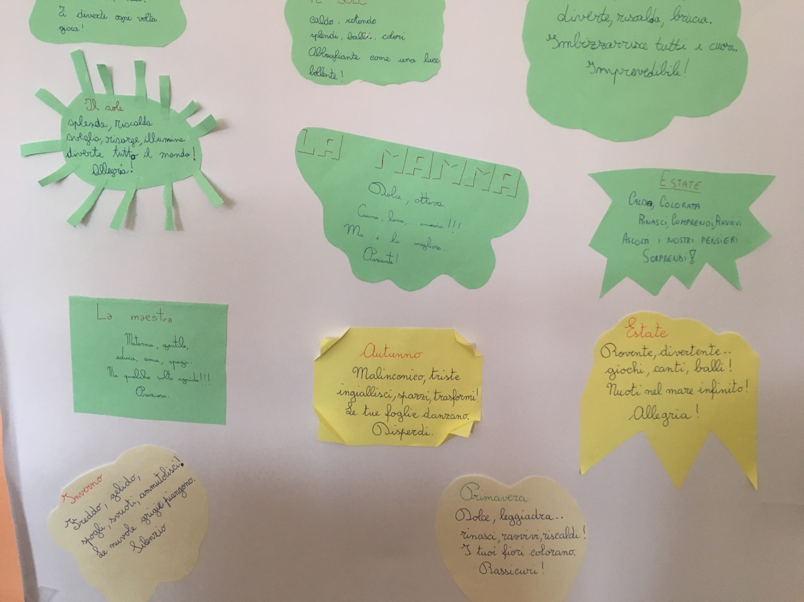

Slide 3
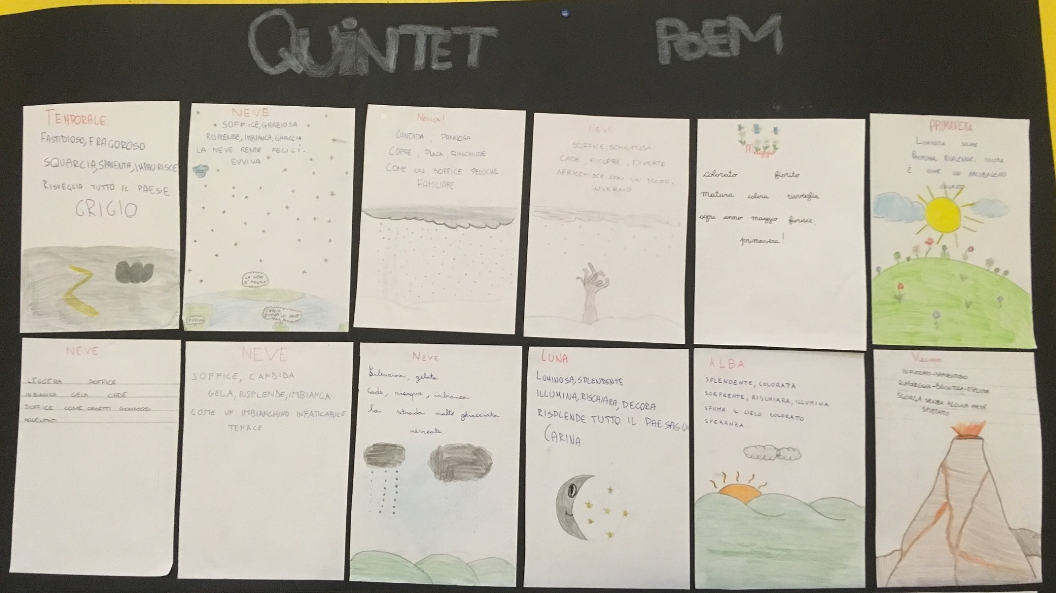

Slide 4
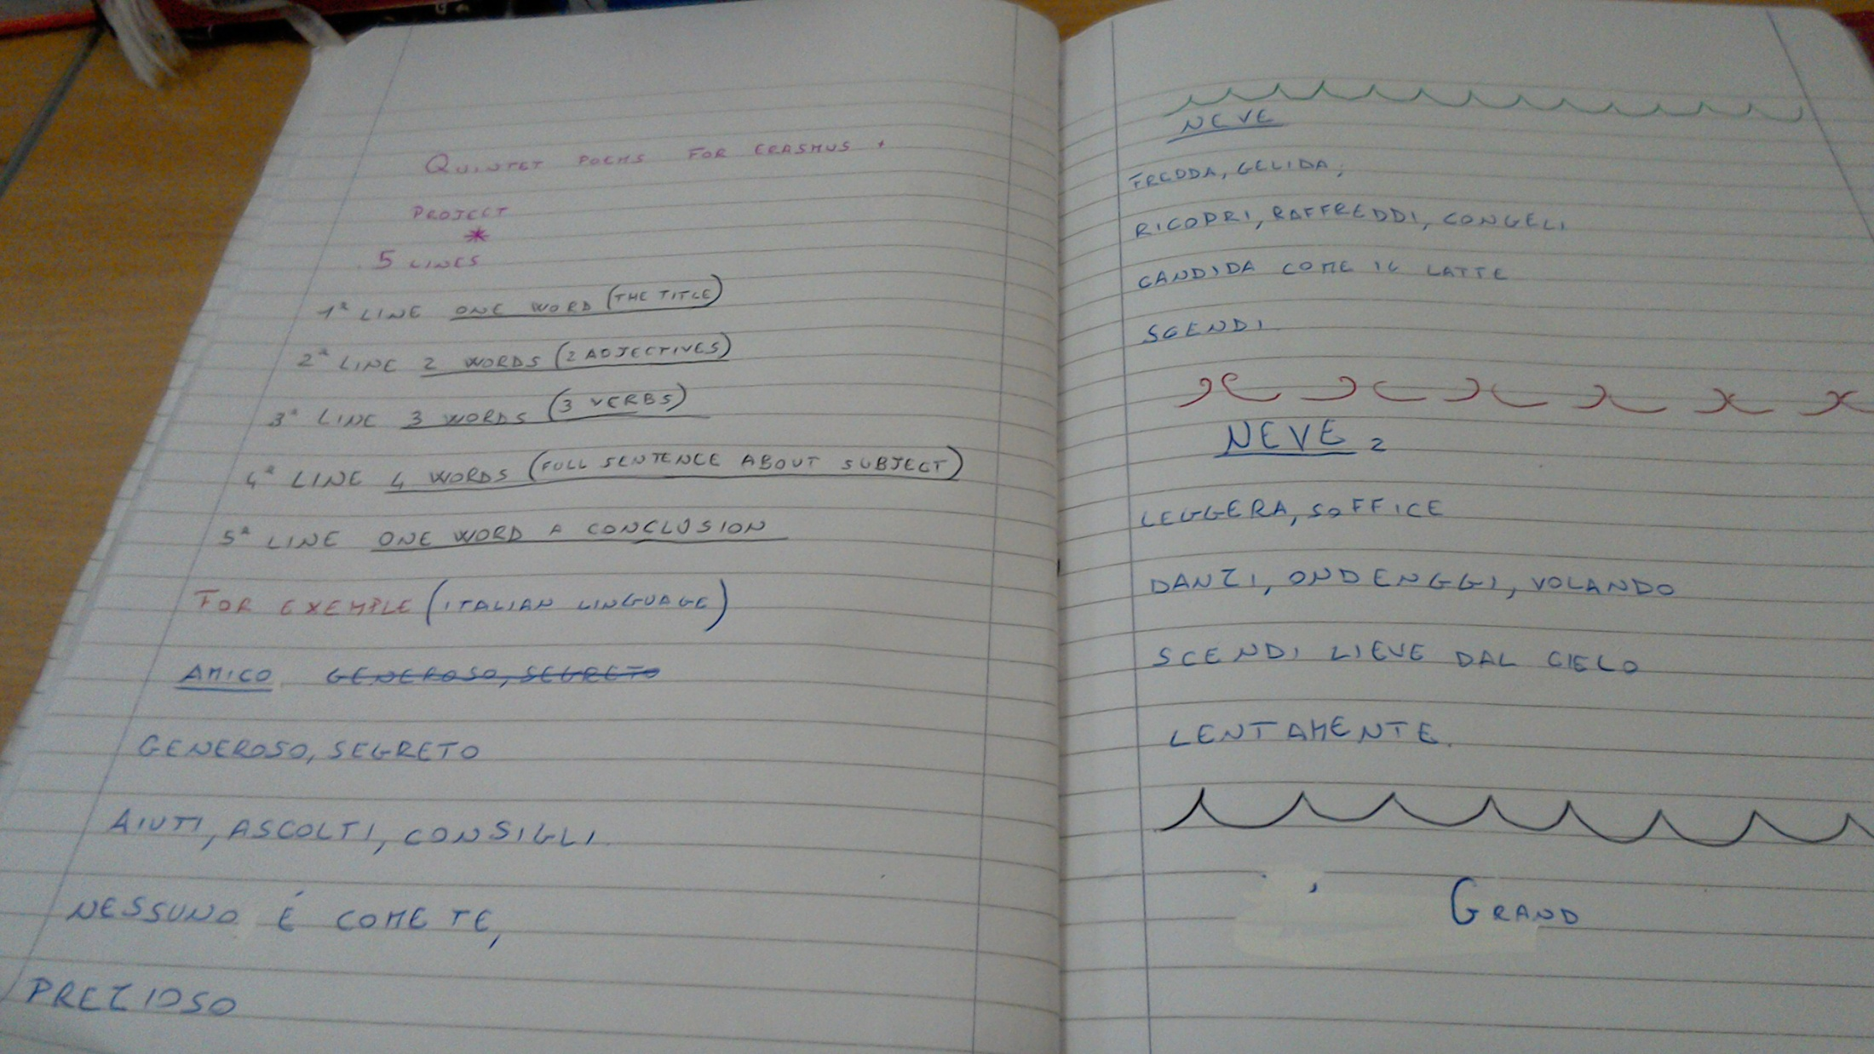

Slide 5
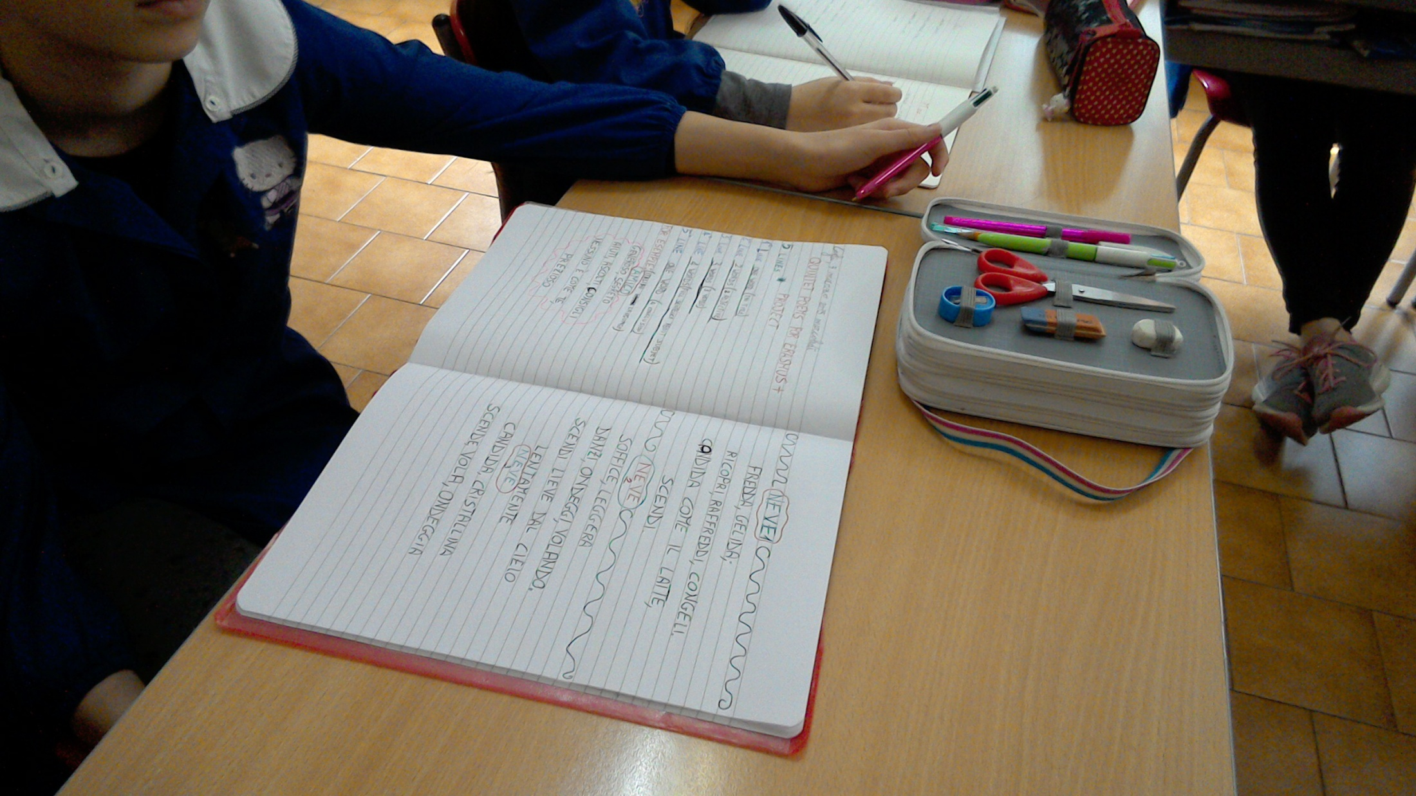

Slide 6
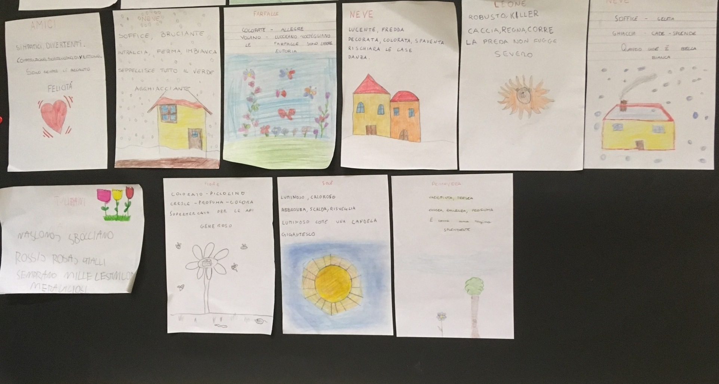

Slide 7
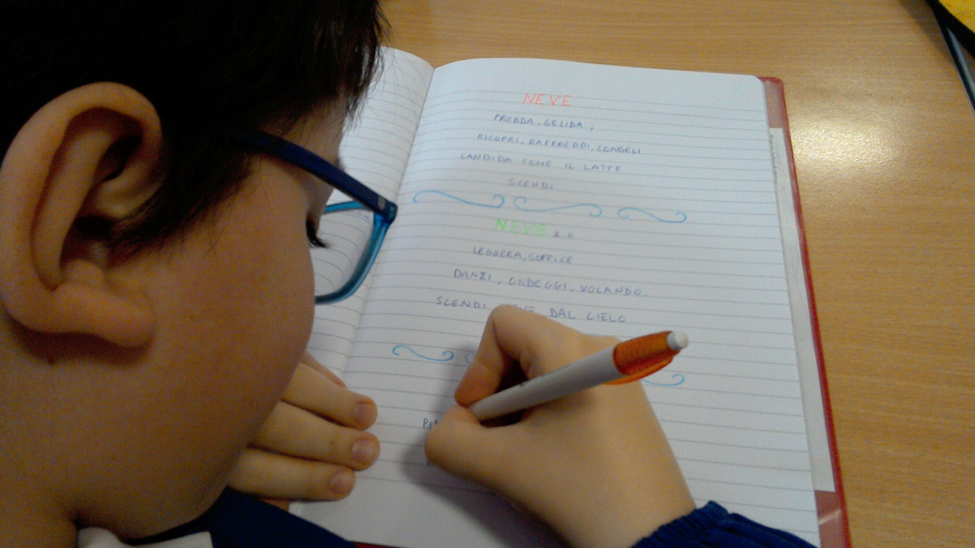

Slide 8
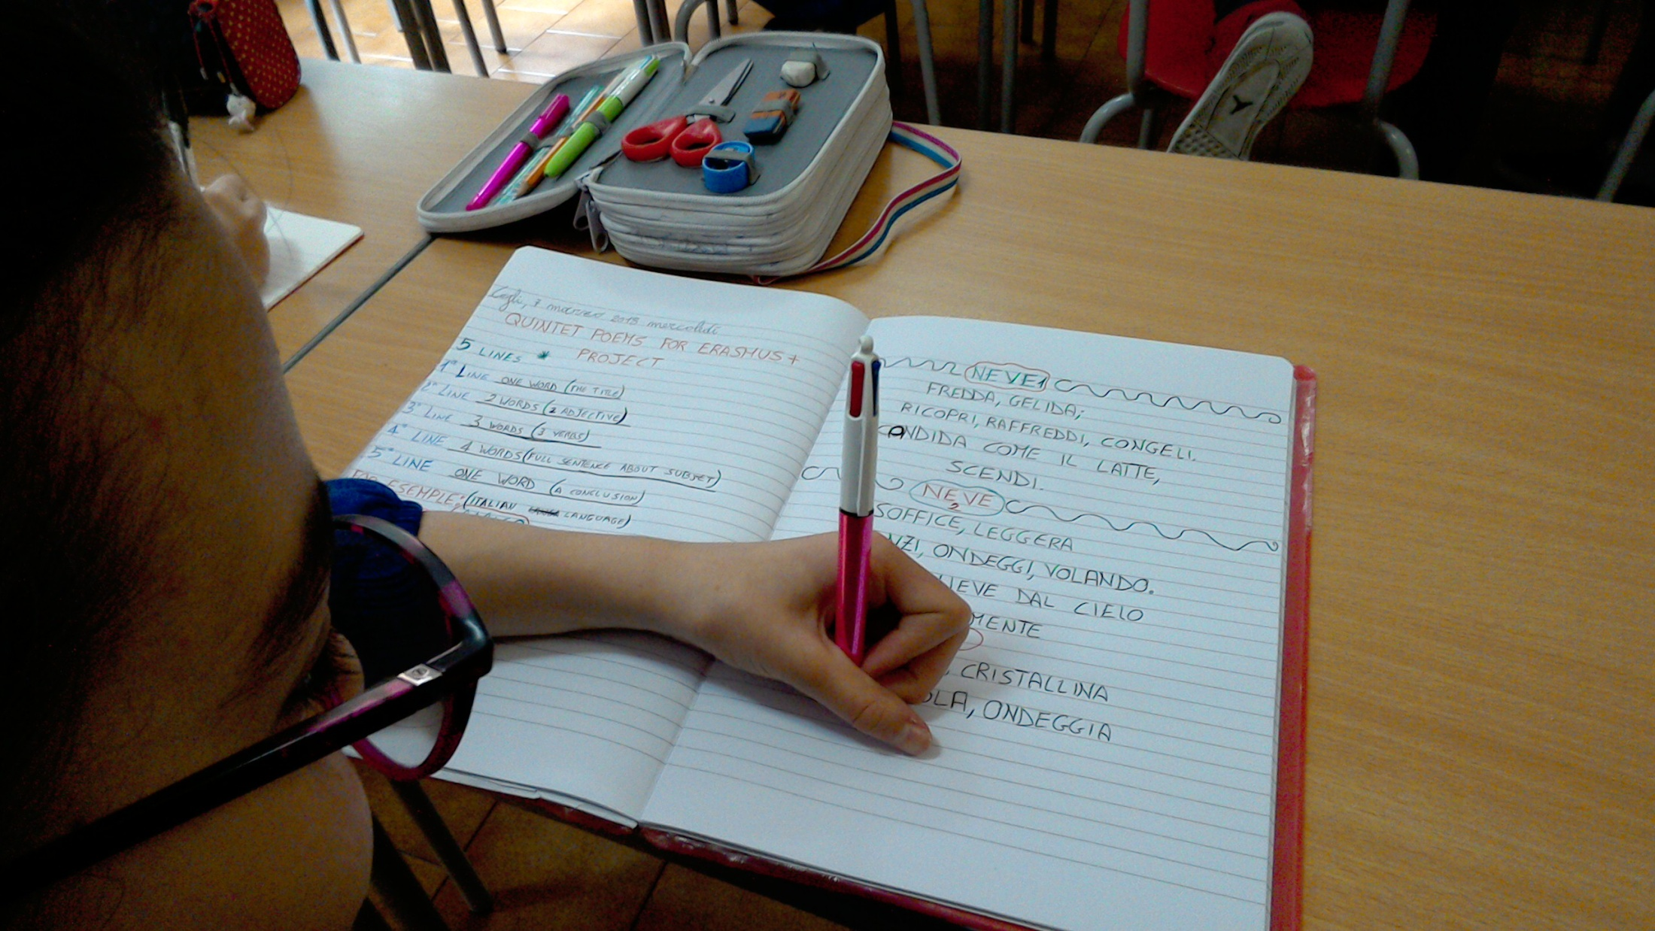

Slide 9
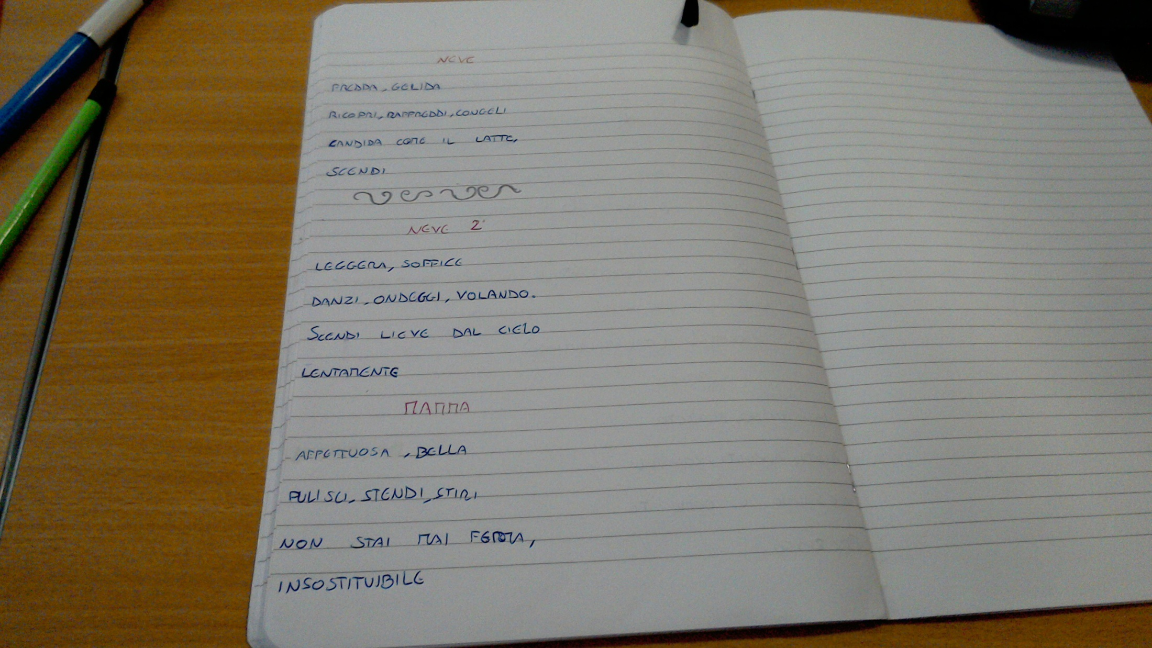

Slide 10
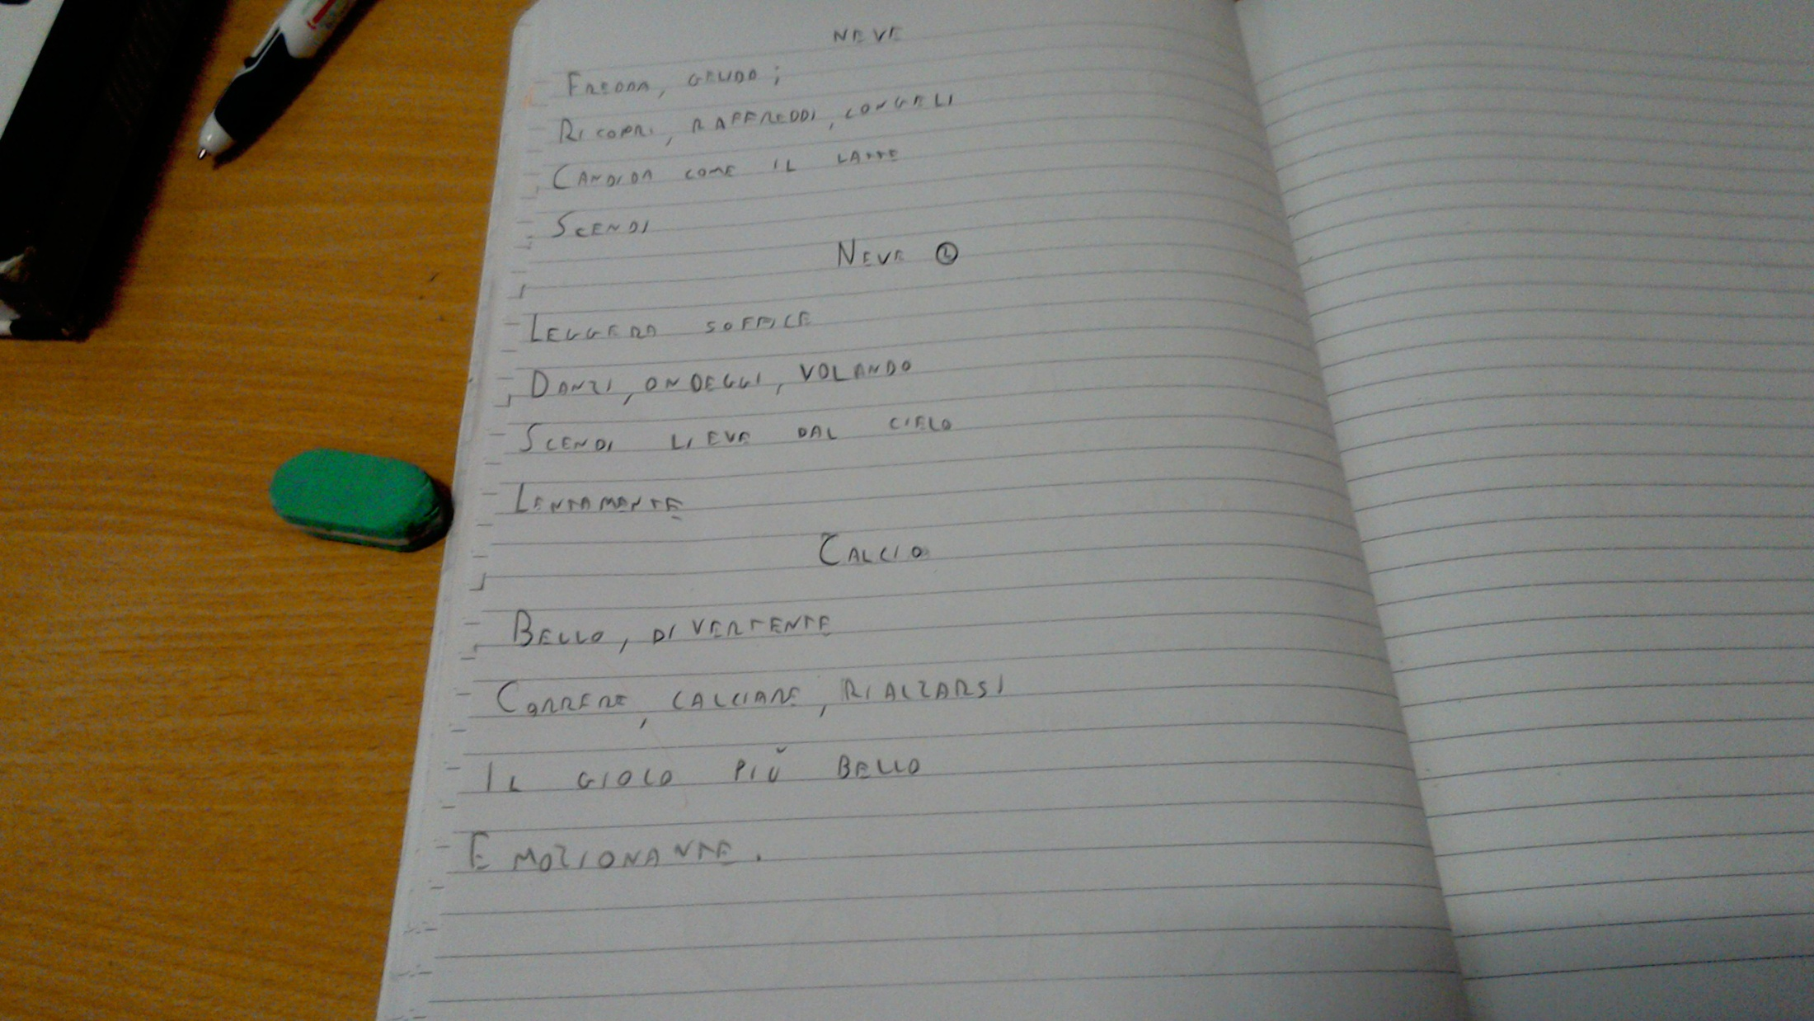

Slide 11
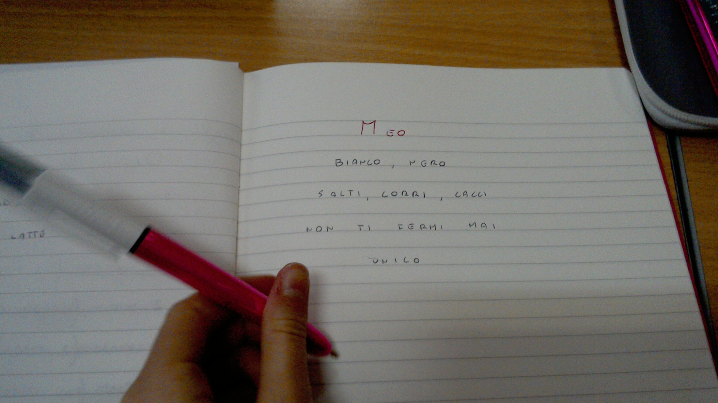

Slide 12
Snow 1
Light, soft
dance, flutter, flying.
Fall, delicate from the sky,
Slowly.
Friend
Generous, secret
help, listen, suggest.
None is as you
precious.
Football
Beautiful, fun.
Running, kicking, standing
It’s the greatest game,
emotional
Snow 2
Cold, freezing
Ricopri, raffreddi, congeli
Bianca come il latte
scendi
Mum
Tender, beautiful,
Clean, spread, iron.
Don’t take a break,
unique.

