Slide 1
ERASMUS+ 2016-2017
Arts and traditions in modern settings

Slide 2
Our countries
Greece
Lithuania
Italy

Slide 3
Italy and its regions

Slide 4
our flag

Slide 5
FACTS AND FIGURES…
President of the Republic:
Population:
Languare:
Religion:
Currency:
Climate:
Time zone:
Sergio Mattarella
59.801.000 abitanti
Italiana
Cattolica
Euro
Temperato
+ 1 hour Greenwich Mean Time

Slide 6
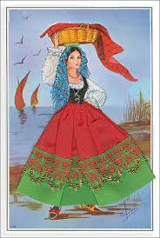
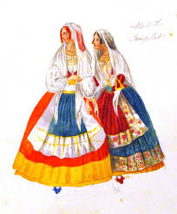
Some regional traditional Costumes

Slide 7
Holidays and school days
Lessons start on 15th September
All Saints’ Holiday : 1st November
The deads’s holiday: 2nd November
Immaculate Conception’s holiday: 8th Dicember
Christmas break: from 24th December to 7th January
Easter break: from 13th to 18th April
Liberation Day: 25th April
Labour day: 1st May
Republic day: 2nd June
Lessons end on June 8th

Slide 8
Our territory
Mountains
Plains
Hills

Slide 9
Occupazione economia

Slide 10
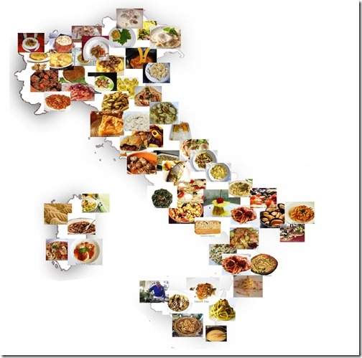
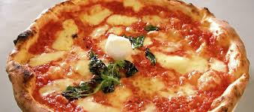
Cibi tradizionali

Slide 11
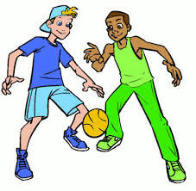
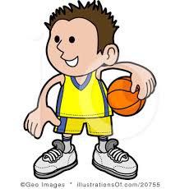
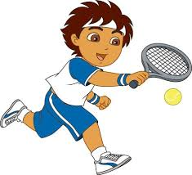
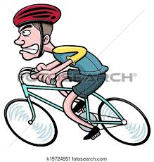
Popular sports

Slide 12
Best regards from the italian sky.

