Slide 1
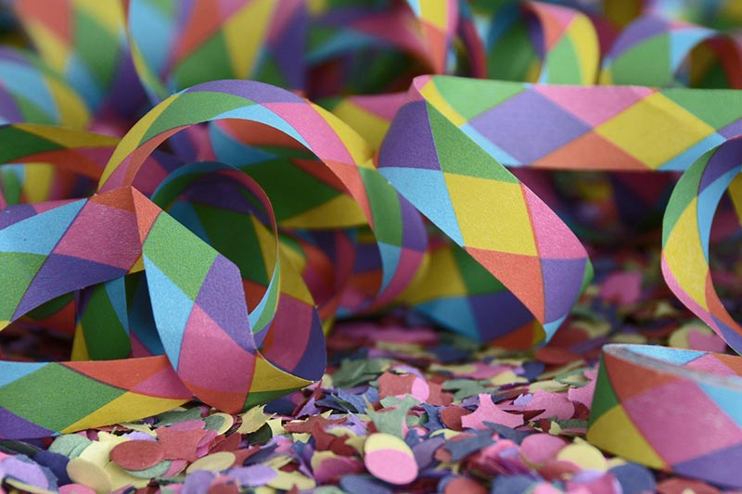
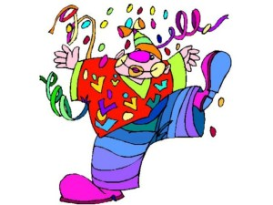
I.C. Tocci Cagli
Carnival daYs
Italy

Slide 2
WHY CARNIVAL WORD?
The Carnival is a festivity which it is celebrated in countries with a Catholic traditions. The celebration often take place in public parades, dominated playful elements and imaginative. In particular, the distinctive and characteristic of the Carnival, is the use of the mask.
The word Carnival comes from the Latin “carnem levare” (“to eliminate meat"), as it indicated the banquet that was held on the last day of Carnival, just before the period of abstinence and fasting of Lent, 40 days before Easter.
The main festivities take place on Carnival Thursday and Tuesday, that the last Thursday and the last Tuesday before Lent. In particular, closing days of the Carnival festivities, as Lent begins with Ash’s Wednesday.

Slide 3
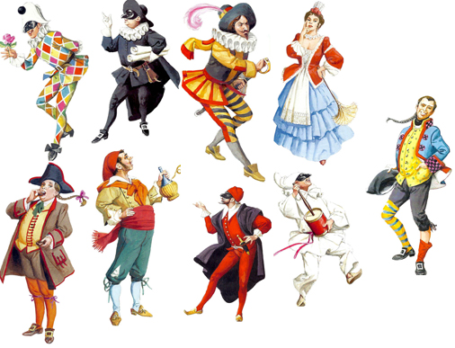
The masks of Art’s comedy
Masks, in the Art’s Comedy, are characters representing the vices and virtues of man: they are stereotypes, they wear a distinctive habit and move with codified gestures. Carlo Goldoni, Venetian playwright, wrote many comedies of these masks.

Slide 4
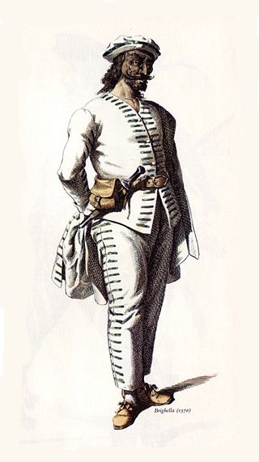
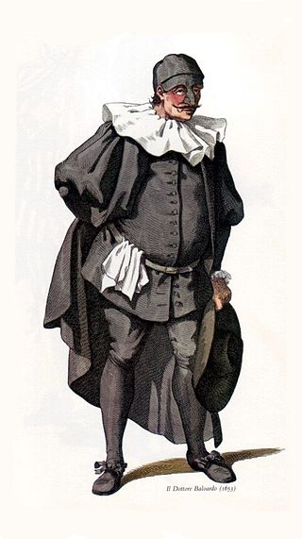
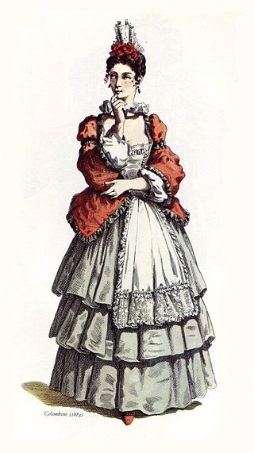
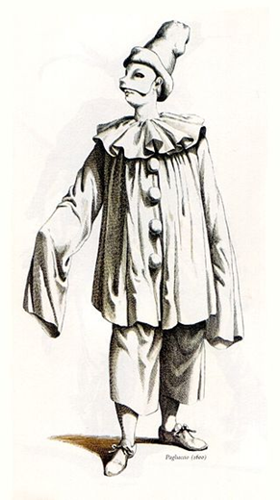
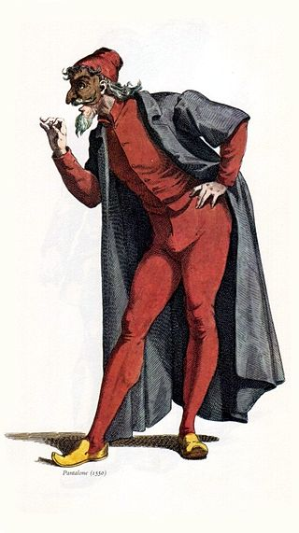
Balanzone: the conceited doctor
Brighella:crafty servant, always at odds with Harlequin
Arlecchino: trickster servant, always hungry
Pulcinella: melancholic servant, silly but at the same time wise
Colombina: maid and mischievous clever, loved by Harlequin
Pantalone: old merchant who loves beautiful women

Slide 5
People wearing masks and costumes, they can totally conceal his identity and thus clears all forms of belonging to social class, gender, religion. Everyone can determine attitudes and behavior based on the new costumes. For this reason, continuous greeting when you meet a new "character" was simply “hello lady mask”.
The joyous undercover participation to this collective ritual disguise was, and still is, the very essence of the carnival.
A carefree period of freedom from their daily routine and all the prejudice and slander, also be imposed.
With the increasingly common practice of disguises for the carnival in Venice he was born from nothing and gradually developed a real trade in masks and costumes.

Slide 6
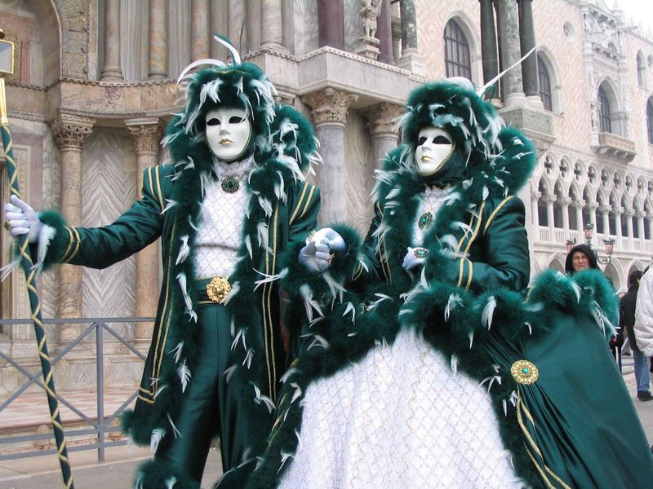
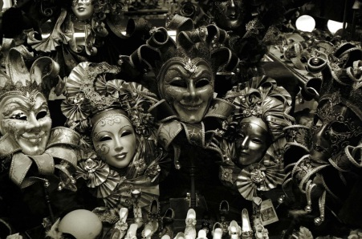
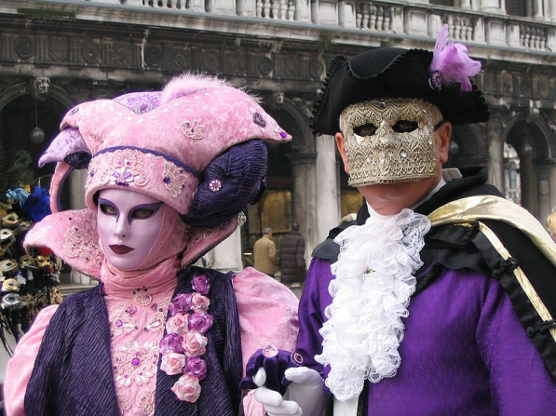
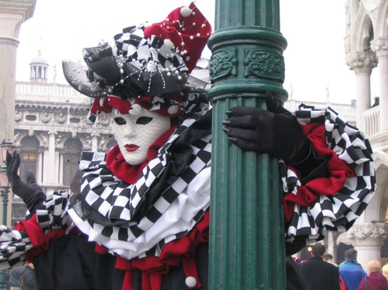
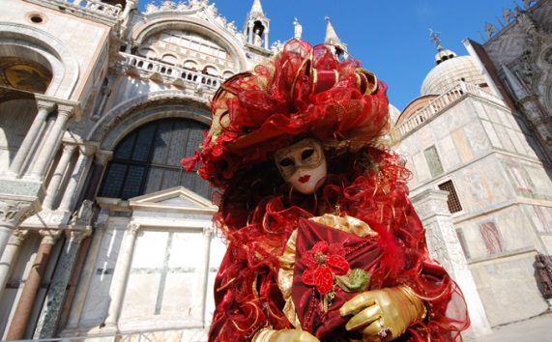
VENICE’S CARNIVAL

Slide 7
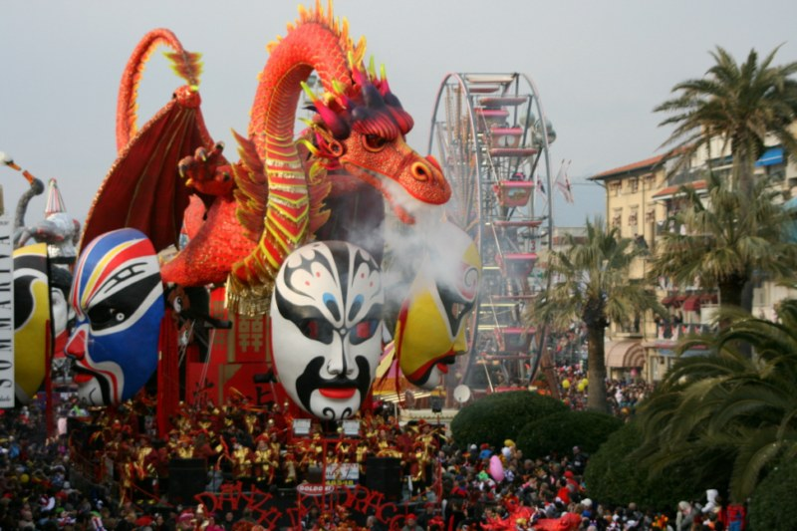
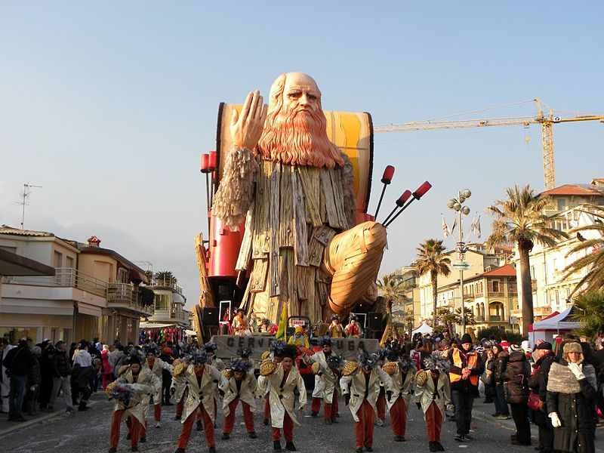
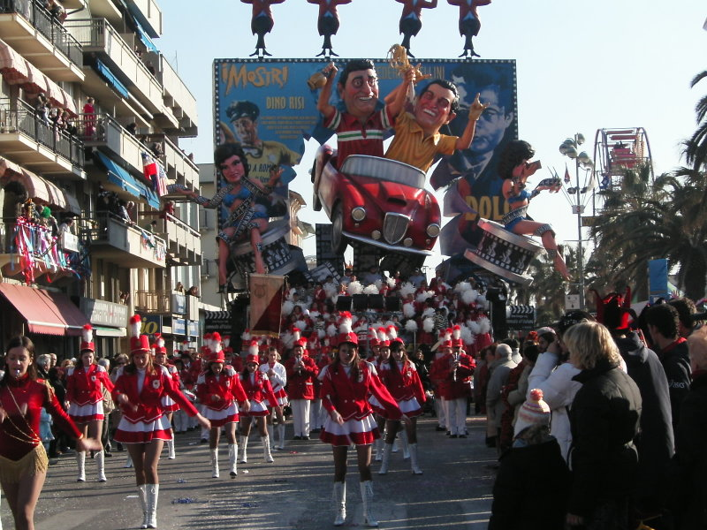
VIAREGGIO’S CARNIVAL
The Viareggio’s Carnival is considered the most important carnival in the world. The wagons are the largest and bustle of the world and parade on the city's waterfront. The main theme of the event is always satire, political and social type.

Slide 8
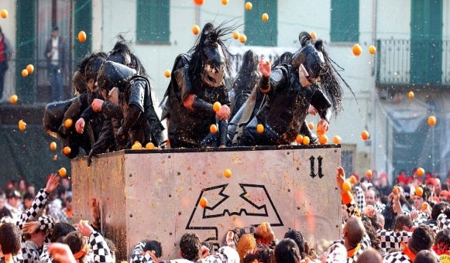
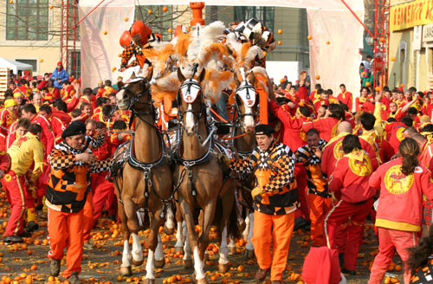
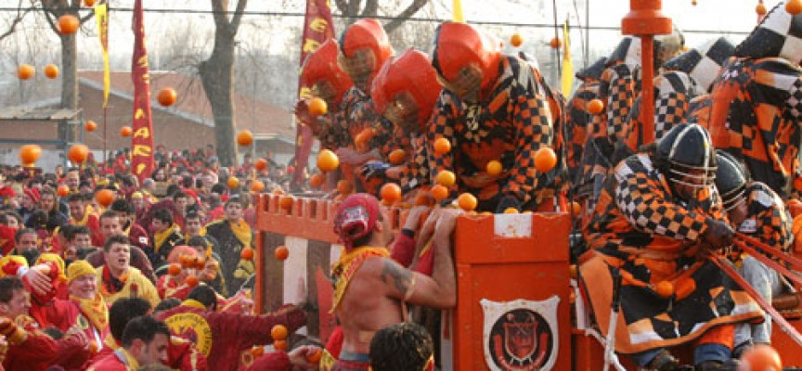
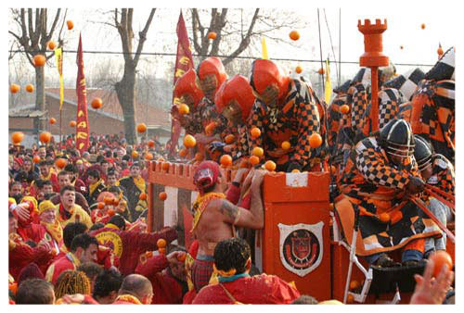
IVREA’S CARNIVAL
The Historic Carnival of Ivrea, famous for its high point of the Battle of the Oranges, is considered one of the oldest and most special in the world, following a ceremonial change several times over the centuries. The entire Carnival is in the form of allegory, the revolt of the citizens for freedom from the tyrant of the city. Meanwhile in the streets of the city parading a procession throwing sweets and gifts to the population.

Slide 9
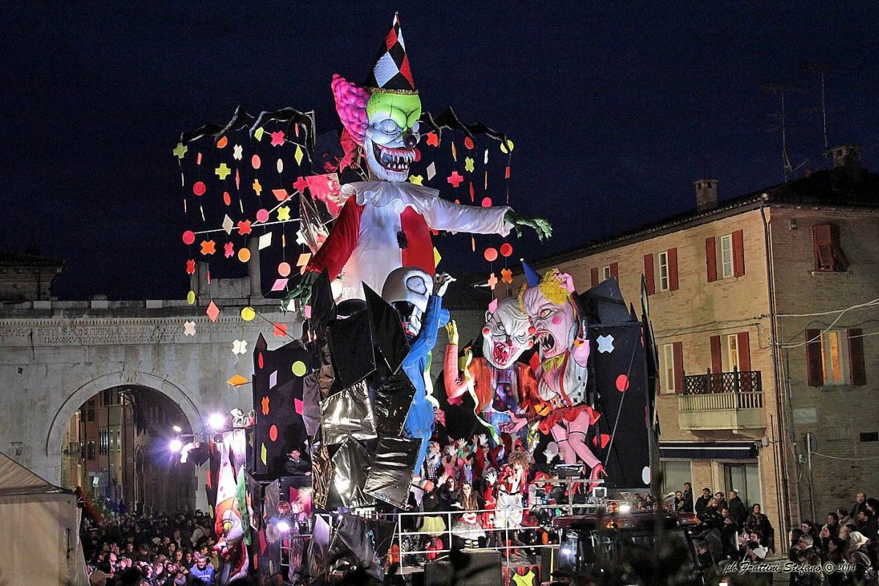
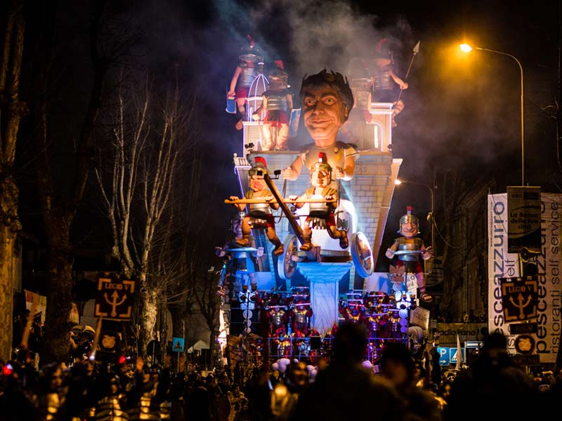
FANO’S CARNIVAL
Fano’s Carnival is one of the oldest Carnival in Italy: the first document in which the typical festivities of the Carnival of the city, dates back to 1347.
A legend has it that he was born by the reconciliation of two important Fano’s families. It is celebrated with floats, masks and costumes, and the end of the festivities with fireworks.

Slide 10
